Slide 1
Software-ontwerp
Presentatie: Iteratie 2
Karina Karapetyan
Laurens Cleemput
Tom Houben
Tri Tran

Slide 2
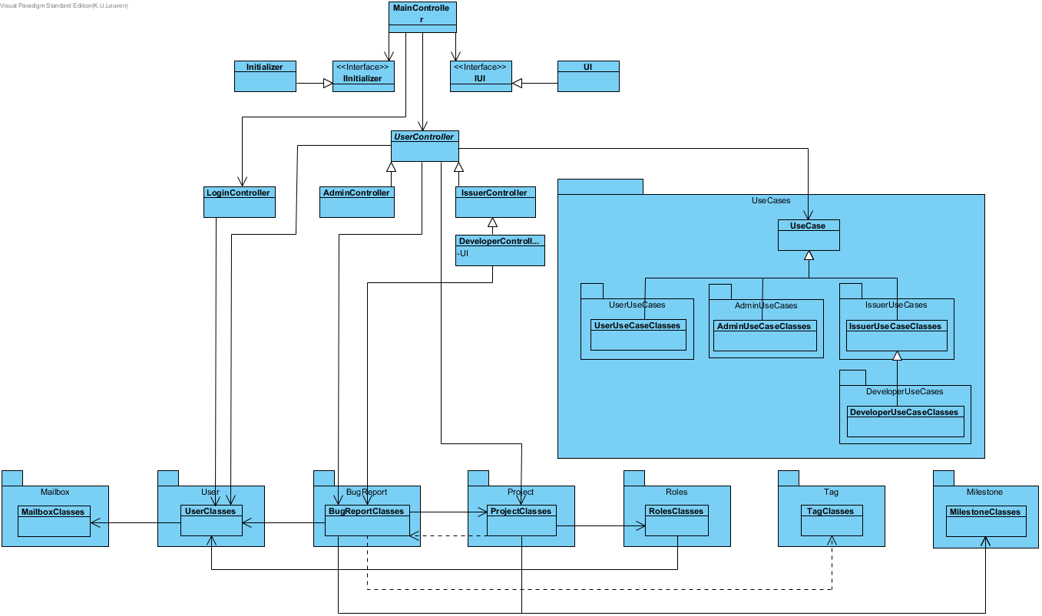
High Level Design

Slide 3
High Level Design
Onderscheid van use cases in aparte packages
Uitbreiding van domeinlaag: Mailbox, Milestone
Uitbreiding domeinlaag toegevoegd zoals in de eerste iteratie

Slide 4
More detailed parts
(x) Services niet meer uitleggen
(x) Uitleg over structuur van use cases (bij extensibility use case toevoegen op uml) + eerste deel van use case SD laten zien tot run()
(x) Uitleg over design patterns: Observer, Memento, Stat + Strat ?
Tonen en uitleggen van sequence diagrams voor de meest complexe use cases, bij voorkeur met link voor design patterns

Slide 5
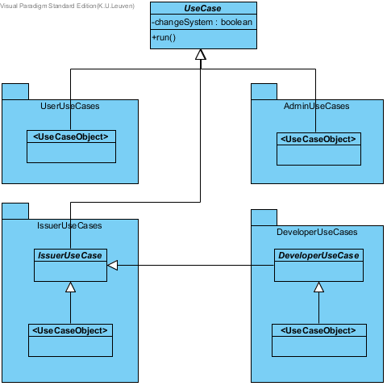
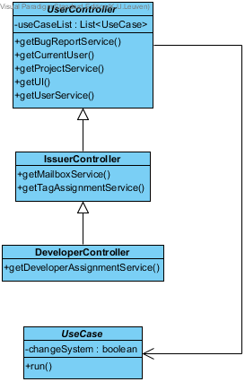
Use Cases

Slide 6
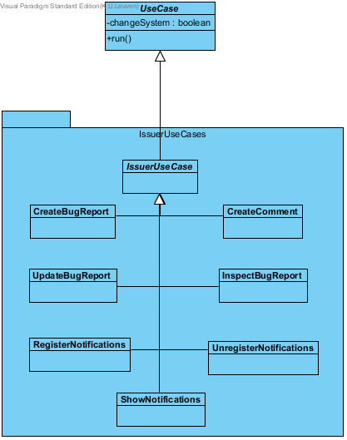
Use Cases: Example

Slide 7
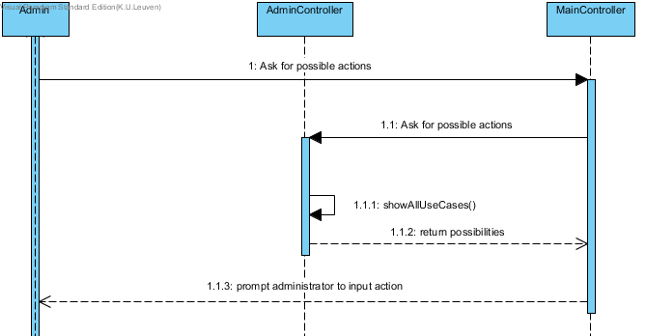
Use Cases: Example

Slide 8
State Pattern
Tags are STATES
The behaviour of a bugreport depends on the tag assigned to it

Slide 9
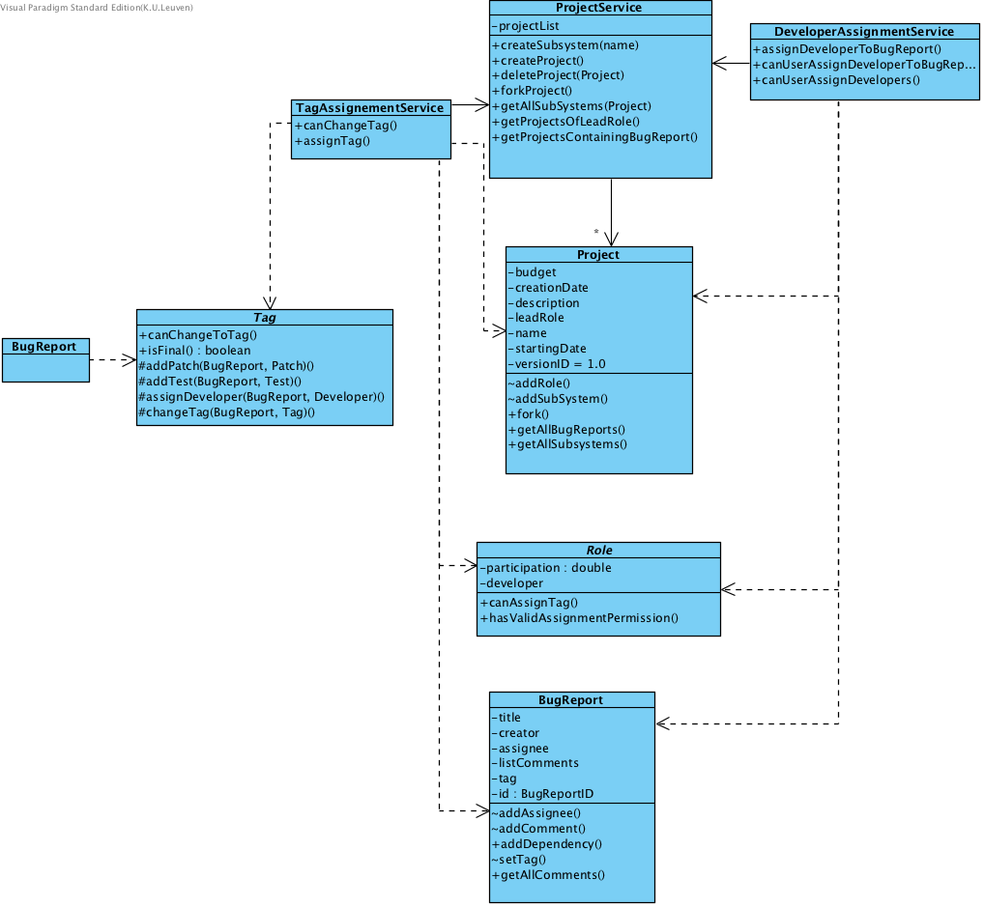
Usage of the domain layer

Slide 10
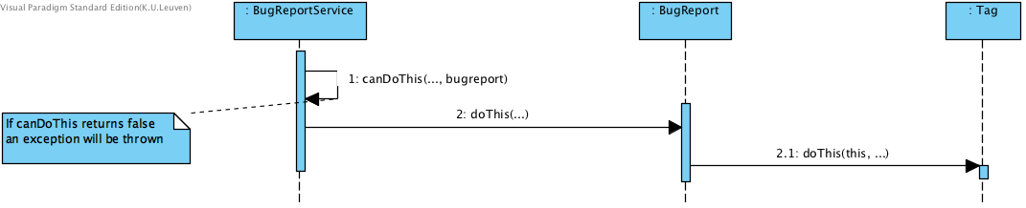
State pattern: Abstract
BugReport calls Tag to execute the function

Slide 11
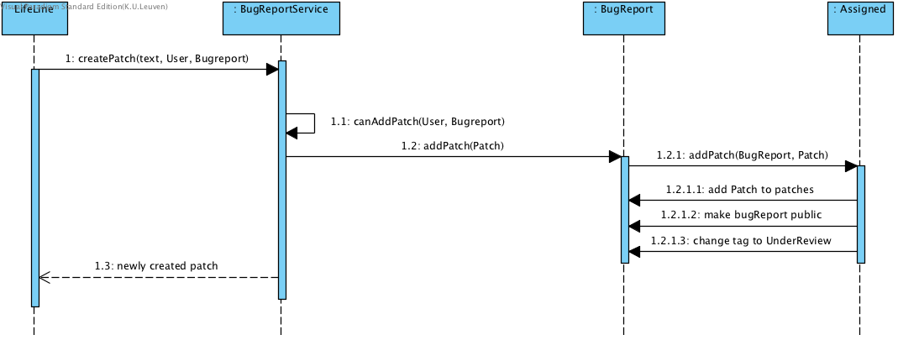
State pattern: Concrete Example
“When a bug report is created, it can be marked as private. … Once the first patch is submitted for the bug report, it is visible for all the users of BugTrap.”
“…after the first patch, the tag of the bug report at stake transitions from Assigned to UnderReview.”
:User

Slide 12
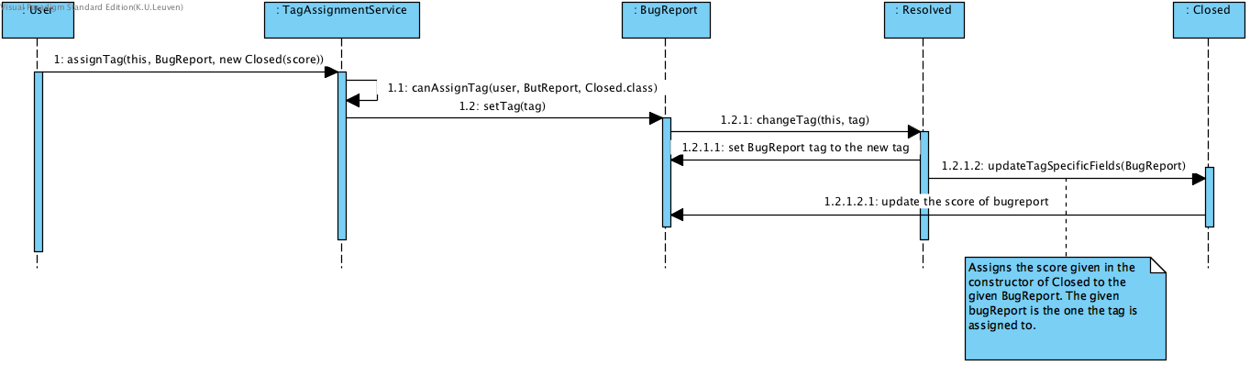
Tag specific infromation
“As a final step, the creator of a resolved bug report can close it (i.e. assign the tag Closed) by specifying how satisfied he is with the solution.”

Slide 13
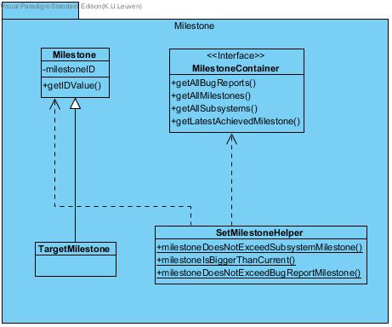
Milestones
Milestone = apart object Toegewezen aan project, subsystem of bug report (Target milestone)
Apart object voor target milestone
→ is optioneel, wordt altijd geïnitialiseerd met gegeven milestone (≠ “M0”)
Container → nodig voor constraints
Helper → checken van constraints

Slide 14
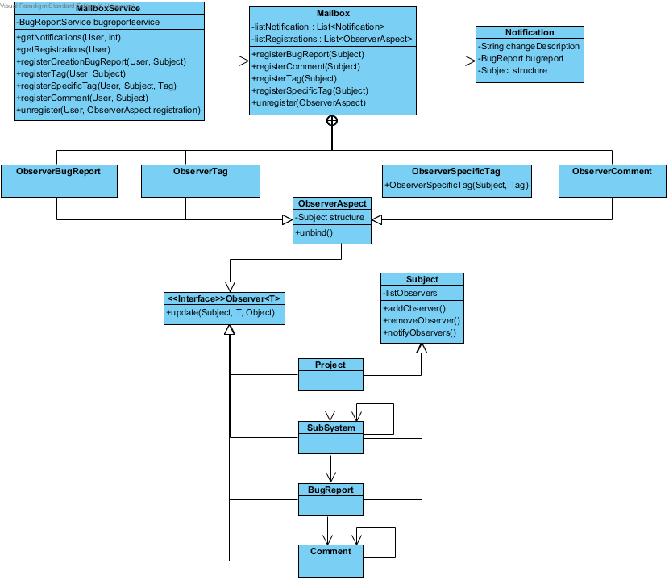
Mailbox system

Slide 15
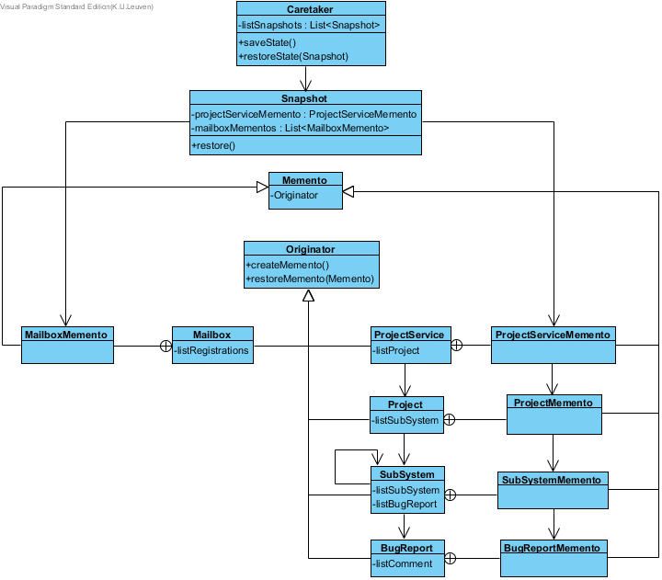
Undo mechanism

Slide 16
Extensibility of the system:
Adding use cases
UI is still completely independent
Interface for the Initializer
Adding constraints concerning tag
Adding new registration types (for mailboxes) = adding new observers
Search methods for bug reports
Adding new objects that could be undone
It was easy to implement the changes from iteration 2 -> great extensibility of our code from iteration 1

Slide 17
Possible improvements
Mailbox creates Observers, could be a task of the MailboxService
Milestone: improvements in the code and structure

Slide 18
Testing approach
Geef coverage + korte samenvatting van werkwijze in iteratie 1

Slide 19
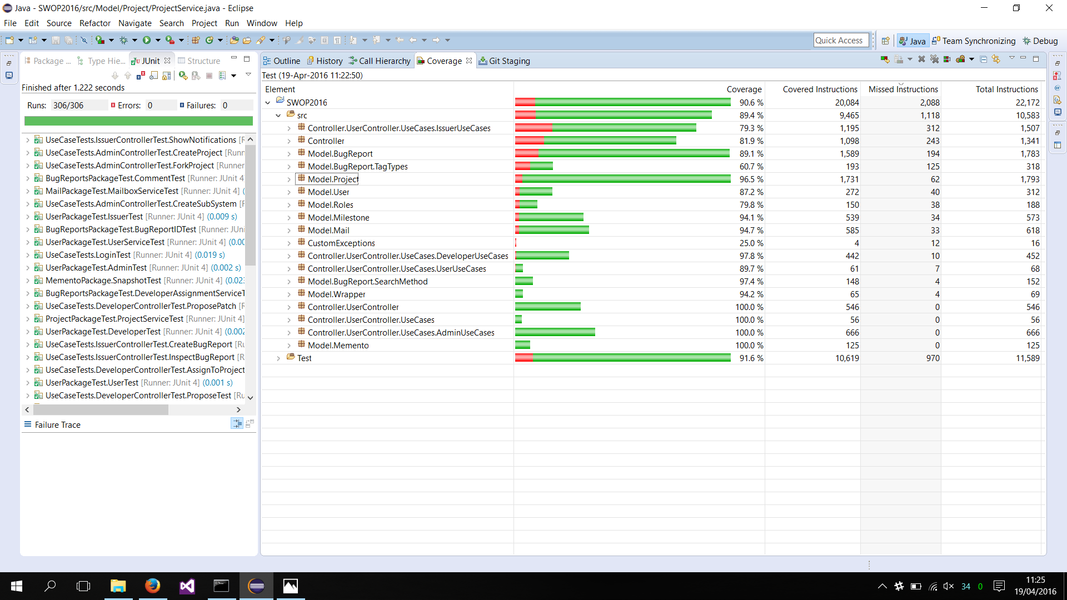
Testing approach

Slide 20
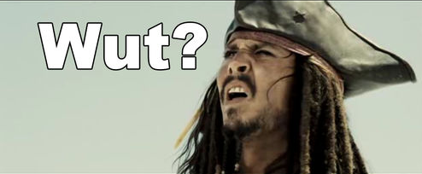
Vragen?

Slide 21
Project management (in uren) TODO UPDATE
Karina Karapetyan
Group work: Individual Work: Study:
Laurens Cleemput
Group work: Individual Work: Study:
Tom Houben
Group work: Individual Work: Study:
Tri Tran
Group work: 31h Individual Work: Study:

Slide 22
Roles
 | Iteratie 1 | Iteratie 2 | Iteratie 3
Design Coordinator | Karina Karapetyan Laurens Cleemput | Tom Houben Karina Karapetyan | TODO INVULLEN (Doorschuiven)
Testing Coordinator | Tri Tran | Laurens Cleemput
Domain Coordinator | Tom Houben | Tri Tran

